Slide 1
Depth Maps Elaboration Using Camera Images And LiDAR Point Clouds
Bersellini Andrea

Slide 2
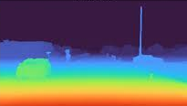
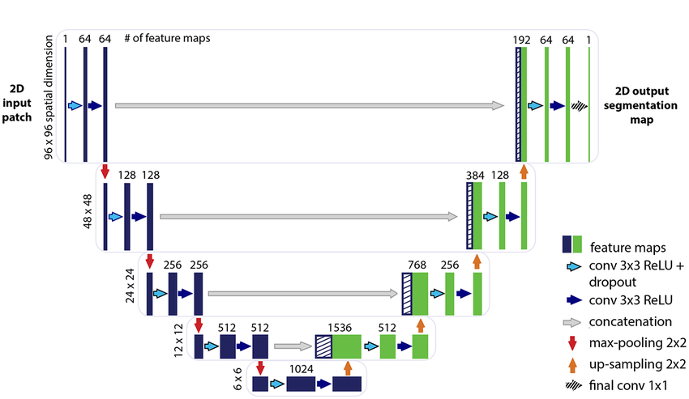
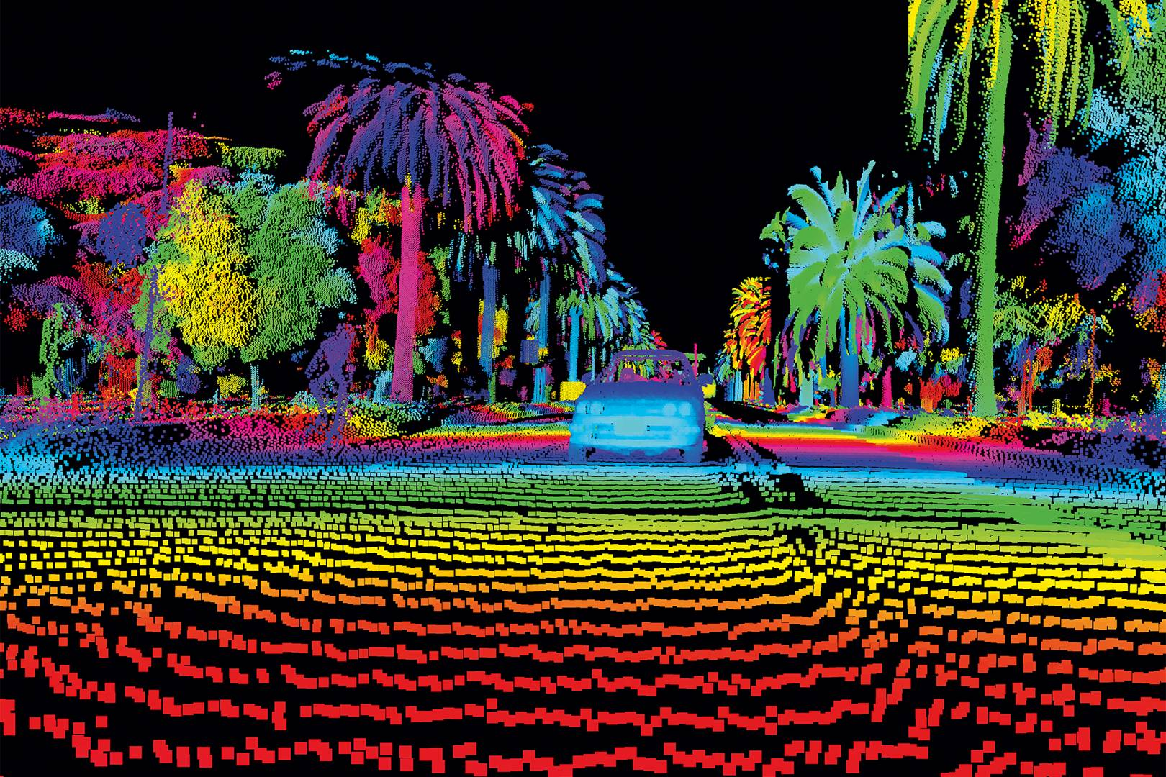
Introduction
Camera
LiDAR
Depth Map

Slide 3
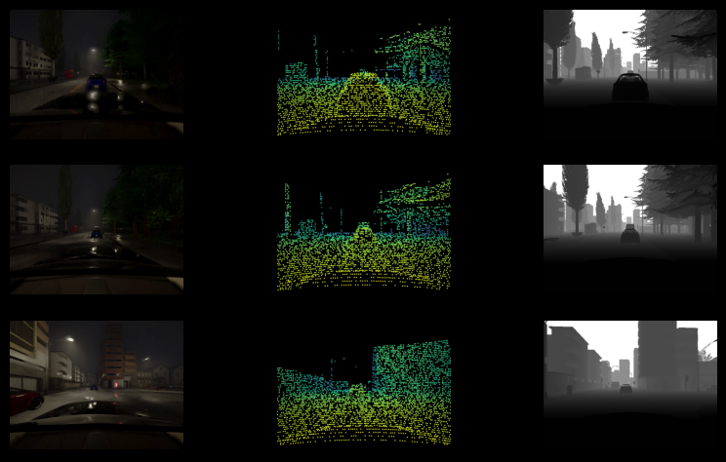
Dataset
Carla Sensor Fusion V8
Camera
LiDAR
Depth Map
Calibration, Fusion, Color Format

Slide 4
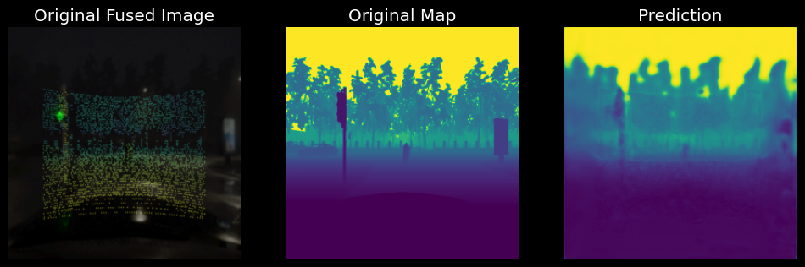
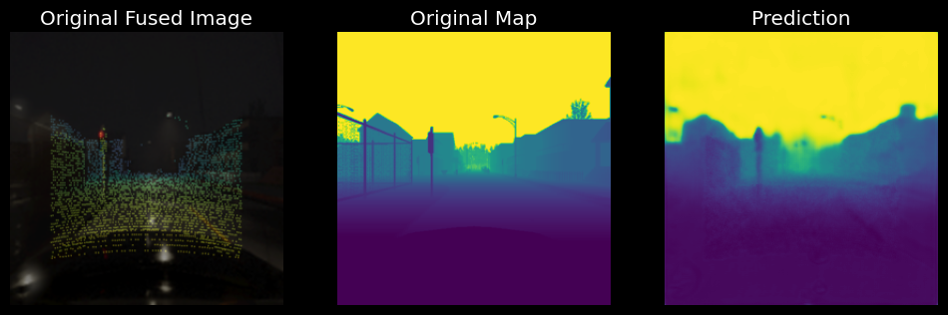
Data-Level Fusion
Data Acquisition
Sensor Data Fusion
Model Training
Model Evaluation

Slide 5
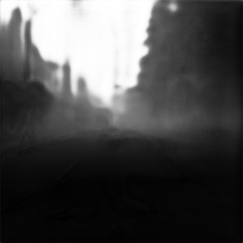
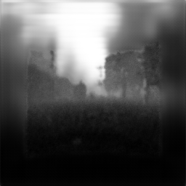
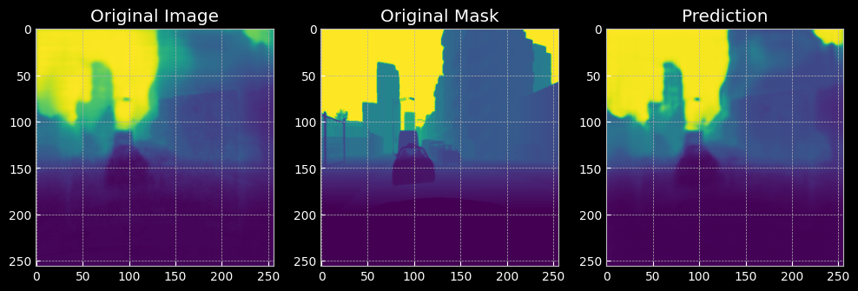
Decision-Level Fusion
Data Acquisition
Model Training
Model Evaluation
Decision Data Fusion
stacking
model

Slide 6
Results
5000 Train
10000 Samples
4000 Train
5000 Test
1000 Test
Early Fusion
Late Fusion
Validation loss: 0.01 ±0.005
Validation loss: 0.01 ±0.005
MSE Loss: Creates a criterion that measures the mean squared error (squared L2 norm) between each element in the input x and target y.

Slide 7
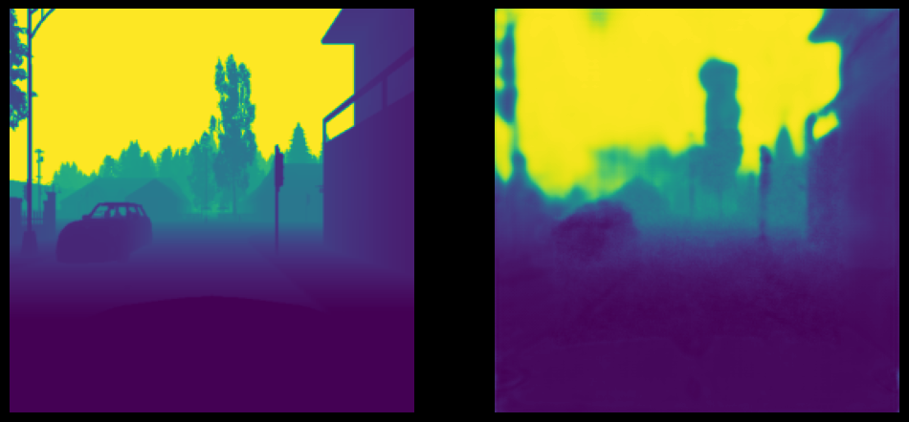
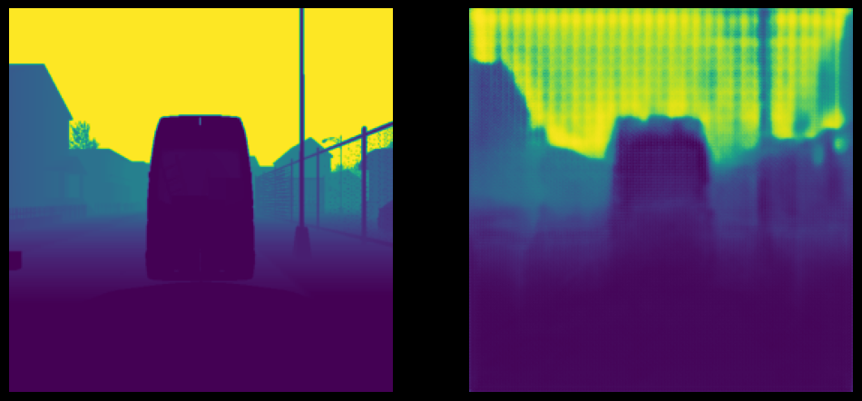
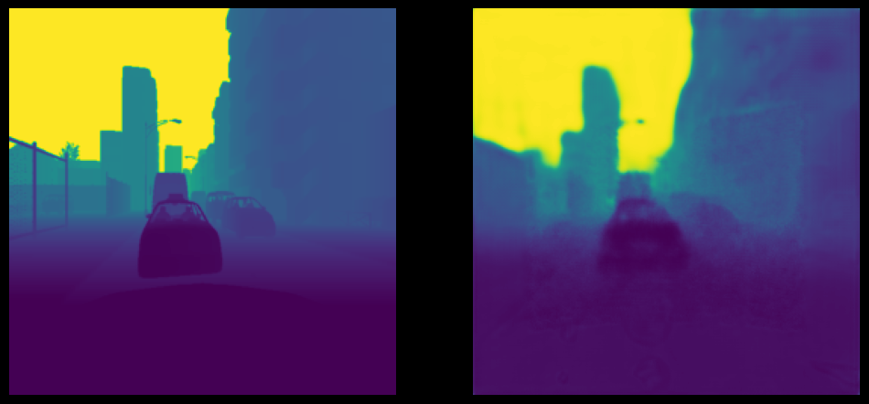
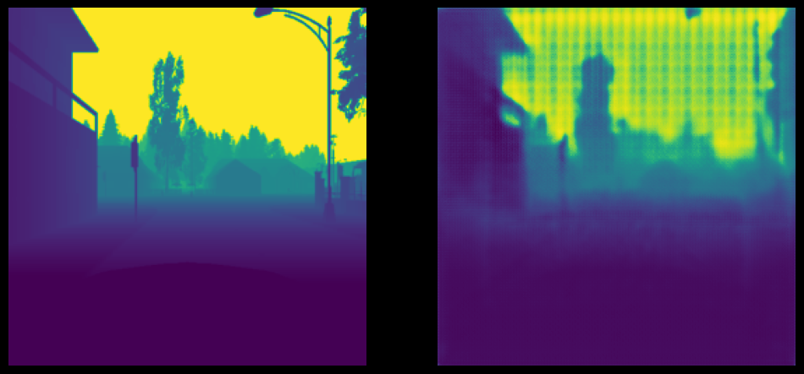
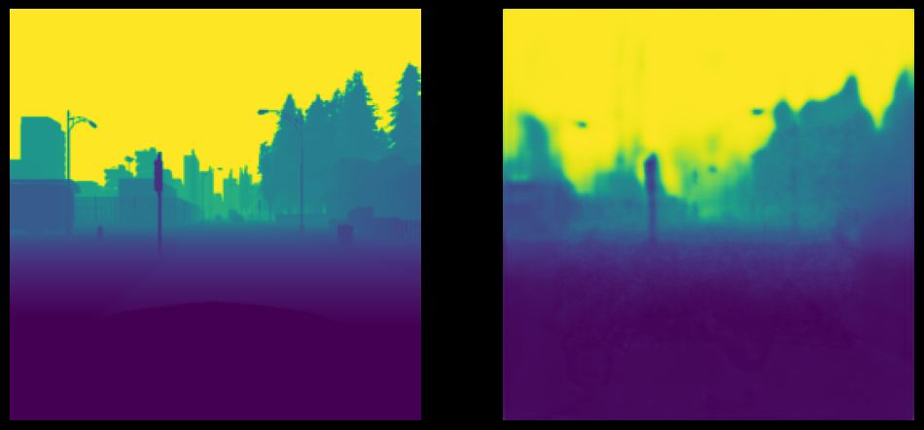
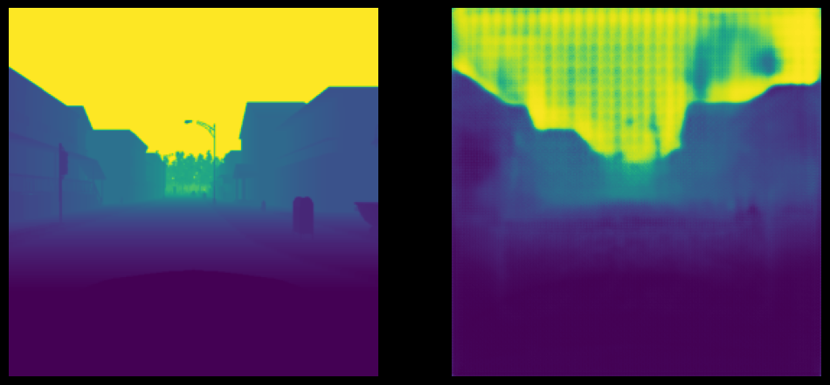
Results
Early Fusion
Late Fusion

Slide 8
Conclusion
Bigger and better LiDAR data
Implement object detection
Try also Feature-Level approach

Slide 9
Thanks for the attention!

